Slide 1
All you need to know about SQL
12 August 2025
By Deboleena Thakur, B. Pharm, MS-HCDA
Intermediate Data Analyst- IDHI, College of Medicine,
University of Arkansas for Medical Sciences

Slide 2
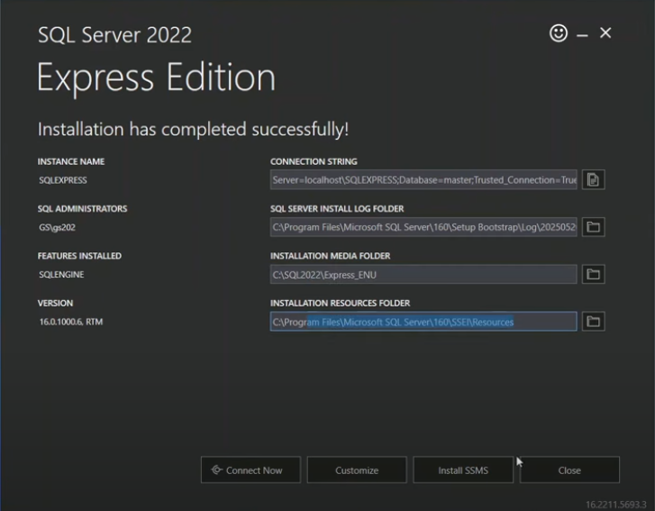
Install Microsoft SSMS and Database Engine-
Step 1- For personal use, install a SQL Server database engine like SQL Express 2022- https://www.microsoft.com/en-us/download/details.aspx?id=104781
SQL Server Express allows you to run a Microsoft SQL Server database locally on your device without needing external servers or special permissions. It works well with SQL Server Management Studio (SSMS), including version 21, for database management.
Click on ‘install SSMS’ button at the end of installation OR click on the link below.
Step 2- Download the latest version of Microsoft SQL Server Management Studio (SSMS)- https://learn.microsoft.com/en-us/ssms/install/install

Slide 3
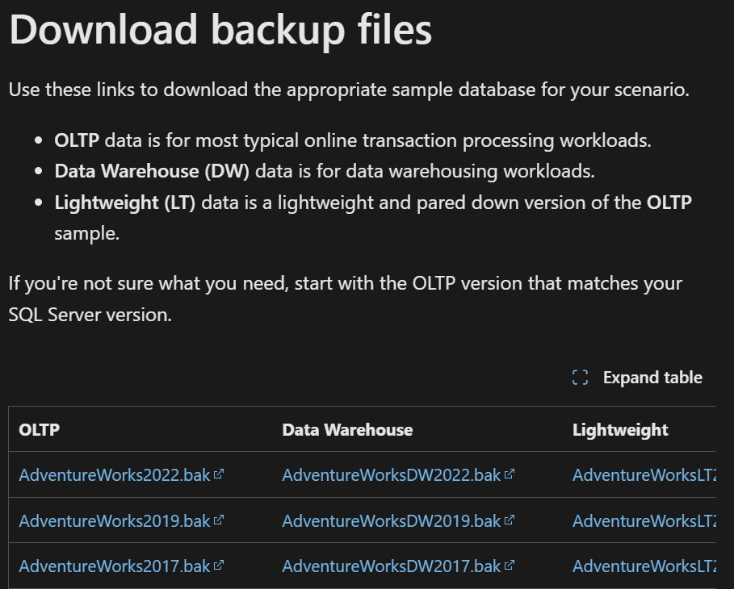
Download the free sample database-
Step 3- Download AdventureWorks sample databases- https://learn.microsoft.com/en-us/sql/samples/adventureworks-install-configure?view=sql-server-ver17&tabs=ssms
- This is a free sample database by Microsoft compatible with its SQL Server
You can select either the OLTP or the Data Warehouse version
**OLTP- Online Transaction Processing, data refers to the transactional data managed by systems designed to handle a high volume of short, frequently updated transactions.

Slide 4
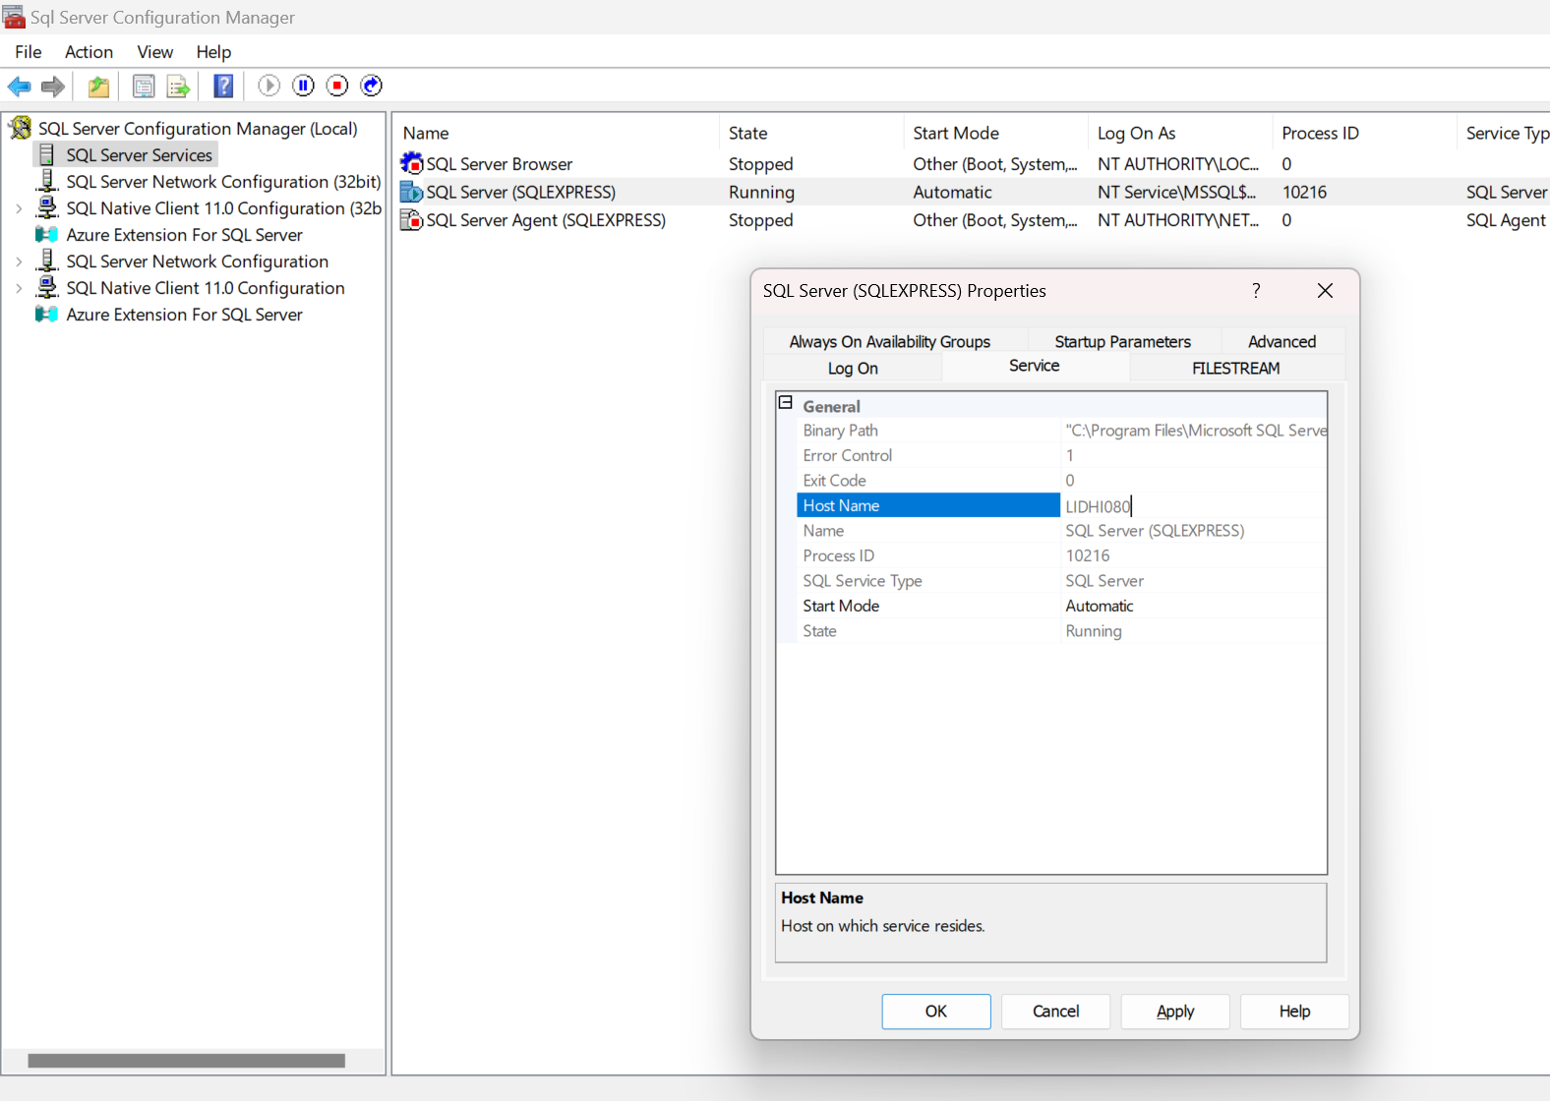

Step 4- Open the SSMS tool and connect to personal device’s server
Go to Windows
Type Sql Server Configuration Manager
Click on SQL Server Services on the left side panel
Right click on SQL Server (SQL EXPRESS) and go to Properties
Copy the Host Name and enter <host name>\SQLEXPRESS on to the Server Name on SSMS21 tool.

Slide 5
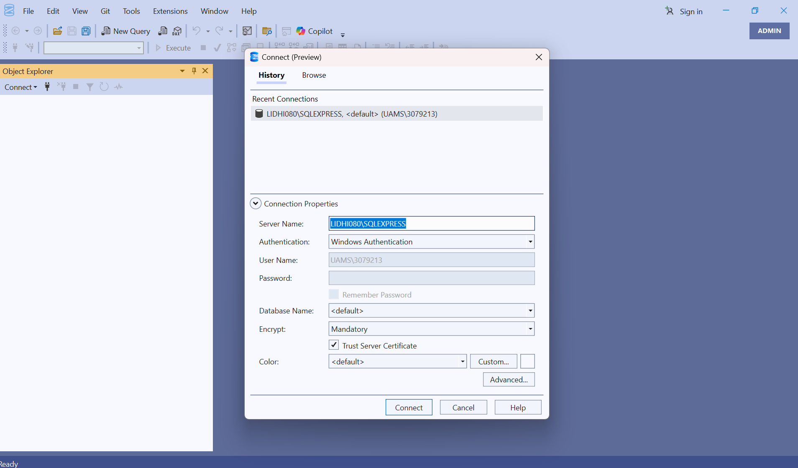
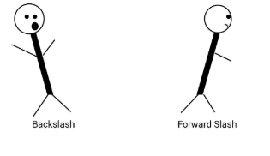


OR
Simply go to Windows search for System Information
Copy the System Name and enter <System Name>\SQLEXPRESS
Click Connect.

Slide 6
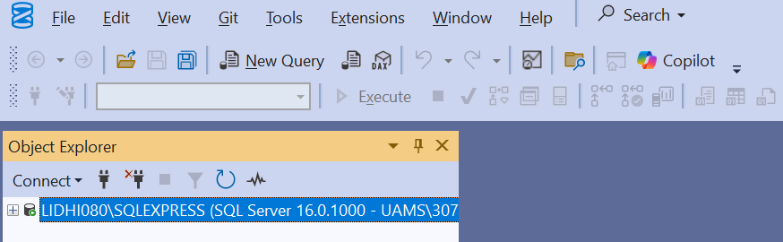
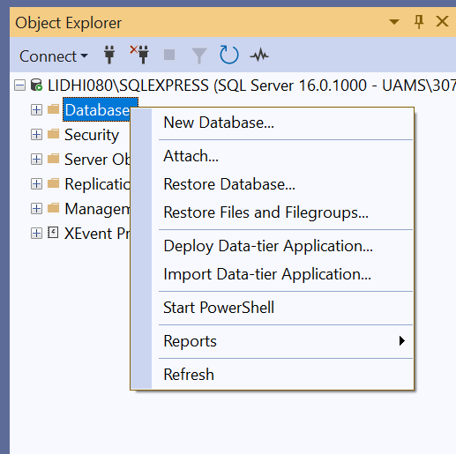
Step 5- Load the AdventureWorks database into the RDBMS
-Click on the + next to the device server name
-Right click next to +Databases and the Restore Database…

Slide 7
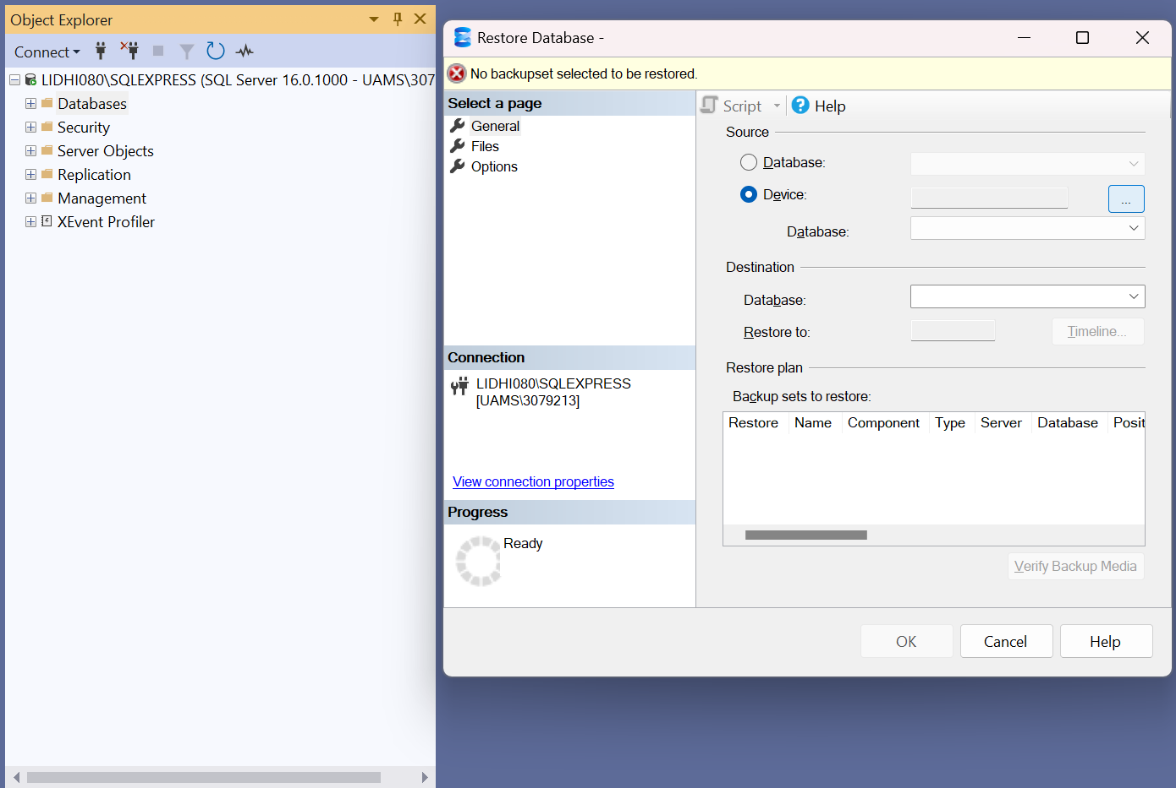
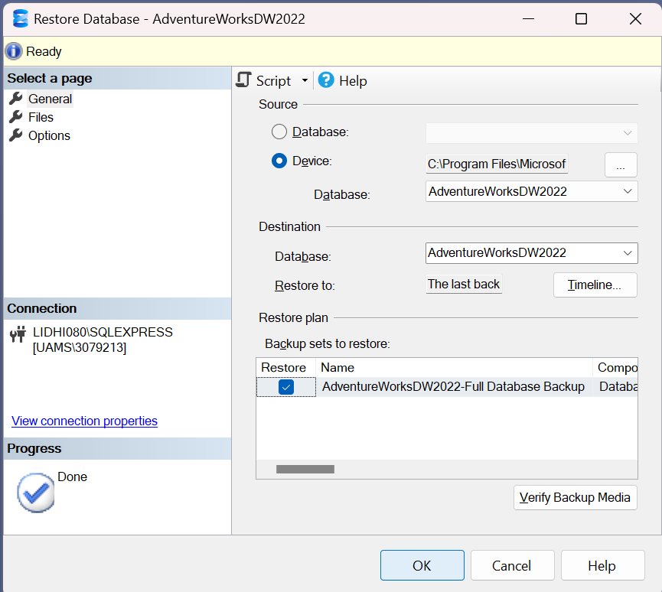
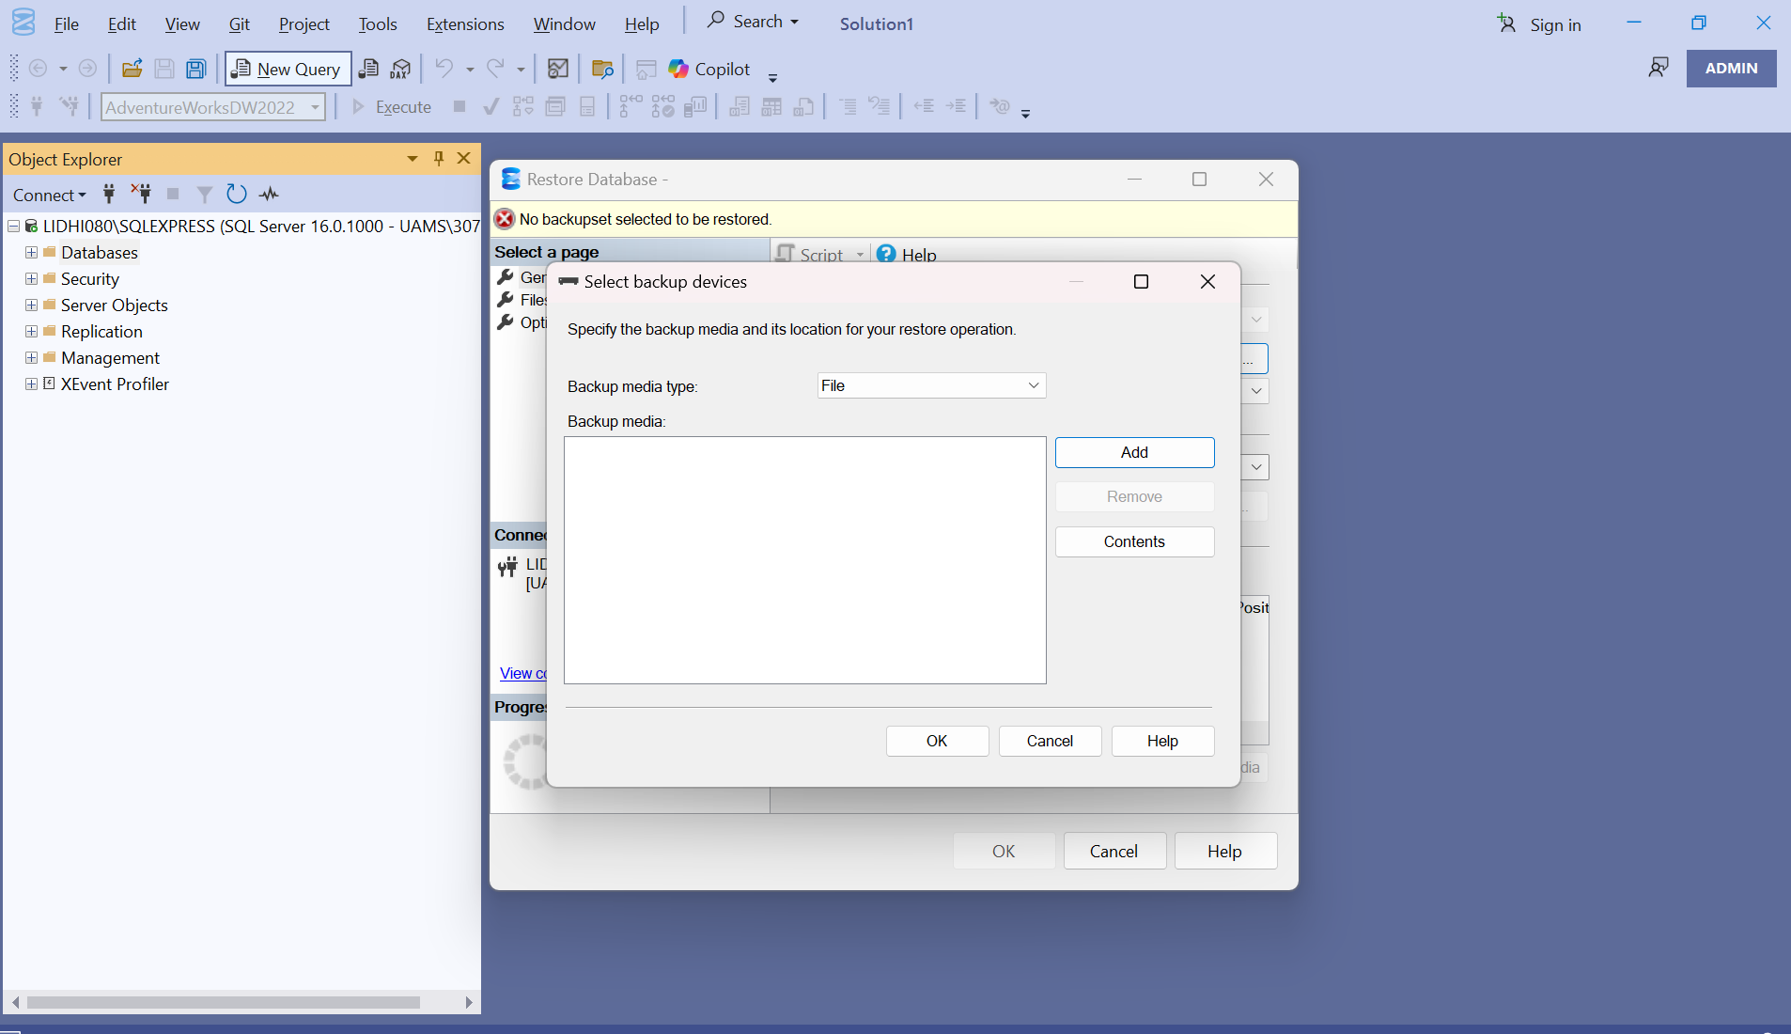
-Select the Device option and click on the three dots and Add the file from the path location. Click OK.

Slide 8
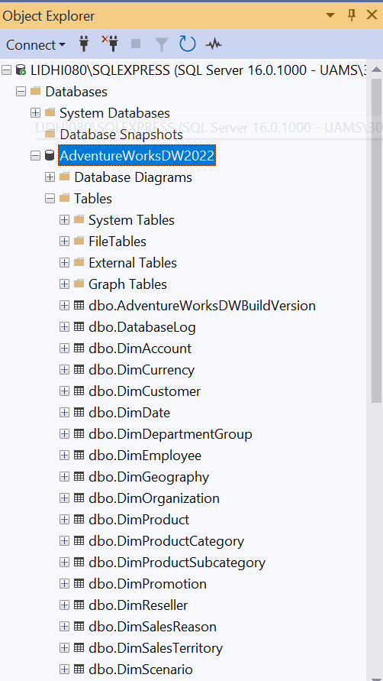
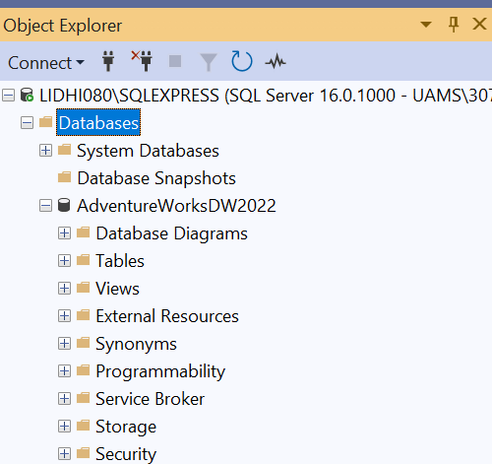
Explore the list of example tables for practice
Click on the +AdventureWorksDW2022 and then go to +Tables to check out all the tables under this database.

Slide 9
Course Breakdown-
Basics of SQL
Demonstration of the SQL commands in the RDBMS
How to use SQL in Research (Project)

Slide 10
Agenda
Introduction to SQL
Join types
Practice SQL commands using Adventure Works database
Entity Relationship Diagrams
Tiny Exercise
Create a database using the Mimic-III Clinical data
Epic Cosmos for Data Architecture
Q&A

Slide 11
Introduction to SQL

Slide 12
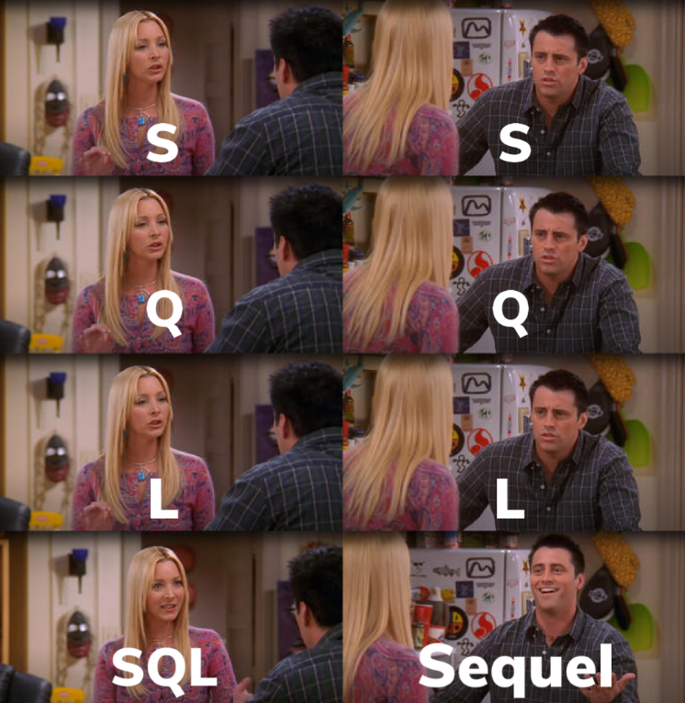
What is SQL?
SQL (Structured Query Language) is a standardized language used to
manage and interact with data in relational databases (e.g., SQL Server,
MySQL, PostgreSQL, Oracle).
Brief History-
-SQL was created in the 1970s by IBM
-adopted commercially by Oracle in 1979
-standardized by American National Standards Institute (ANSI) in 1986.
Key SQL Functions:
-DDL (Data Definition Language): Create, alter, or drop tables and structures.
-DML (Data Manipulation Language): Insert, update, delete, and query data.
-DCL (Data Control Language): Grant or revoke user access and permissions.
SQL is declarative language- you describe what you want, not how to do it.
While syntax may vary slightly across systems, core SQL commands are consistent.

Slide 13

SQL Order of Writing vs. Order of Execution
Order of Writing (How You Write the Query)
SELECT column
FROM table
WHERE condition
GROUP BY column
HAVING condition
ORDER BY column
LIMIT number;
2. Order of Execution (How SQL Actually Processes It)
FROM → Identify the tables and join them if needed.
WHERE → Filter rows that meet the condition.
GROUP BY → Group the remaining rows.
HAVING → Filter groups based on conditions.
SELECT → Choose the columns or calculations to output.
ORDER BY → Sort the final results.
LIMIT / OFFSET (if used) → Return only the required number of rows.
"Silly Frog Wear Green Hat On Lake"

Slide 14
Some common terminologies used-
Syntax → The rules and structure for writing SQL statements (like grammar in a language). Example: SELECT column_name FROM table_name WHERE condition; is the syntax pattern.
Command → A specific SQL instruction that tells the database what to do. Example: SELECT * FROM Customers; is a command to retrieve all customer data.
Clause → A component or section of an SQL command that performs a specific task. Example: In SELECT Name FROM Customers WHERE Country = 'USA';, the WHERE Country = 'USA' part is a clause that filters results.

Slide 15
Data types: SQL Server (SSMS) vs. SQLite
Usage | SQL Server (SSMS) Data Type | SQLite Data Type | Example Usage
Whole numbers | INT, BIGINT, SMALLINT, TINYINT | INTEGER | Storing counts, IDs (CustomerID = 101)
Decimal numbers | DECIMAL(p,s), NUMERIC(p,s) | REAL (for floating point), NUMERIC (for fixed precision) | Storing prices (Price = 19.99), weights
Floating point | FLOAT, REAL | REAL | Scientific values, measurements
Fixed-length text | CHAR(n) | TEXT | Country codes ('US')
Variable-length text | VARCHAR(n), NVARCHAR(n), TEXT | TEXT | Names, descriptions
Large text | TEXT (deprecated: NTEXT) | TEXT | Articles, comments
Date and time | DATE, DATETIME, DATETIME2, TIME | TEXT (ISO format), REAL (Julian), or INTEGER (Unix timestamp) | Birthdates, timestamps
Boolean values | BIT | No dedicated type — use INTEGER (0/1) | Yes/No flags (IsActive = 1)
Binary data | VARBINARY, BINARY, IMAGE (deprecated) | BLOB | Storing images, files
Unique identifier | UNIQUEIDENTIFIER (GUID) | TEXT | UUIDs for unique records
Money values | MONEY, SMALLMONEY | No dedicated type — use NUMERIC or REAL | Product prices, salaries
Arrays / JSON | Not native — use NVARCHAR(MAX) or JSON (in Azure SQL) | TEXT (store JSON) | Storing structured JSON data
Notes:
SQLite doesn’t have strict types like SQL Server, and it uses something called type affinity, meaning the type you declare is more flexible.
SQL Server strictly enforces data types, while SQLite is more relaxed, which means you could accidentally store different kinds of data in the same column if you’re not careful.
In SQLite, the main data type categories are TEXT, REAL, INTEGER, BLOB, and NUMERIC.

Slide 16
Important terms
1. Database Structure
Database – A structured collection of data.
Table – A collection of rows and columns storing related data.
Record/Tuple – A single data entry in a table or the row.
Field/Attribute – A specific category of data within a table or the column.
Schema – Blueprint or structure of the database.
Index – Improves search speed in a table.
View – A saved query that displays data from one or more tables.

Slide 17
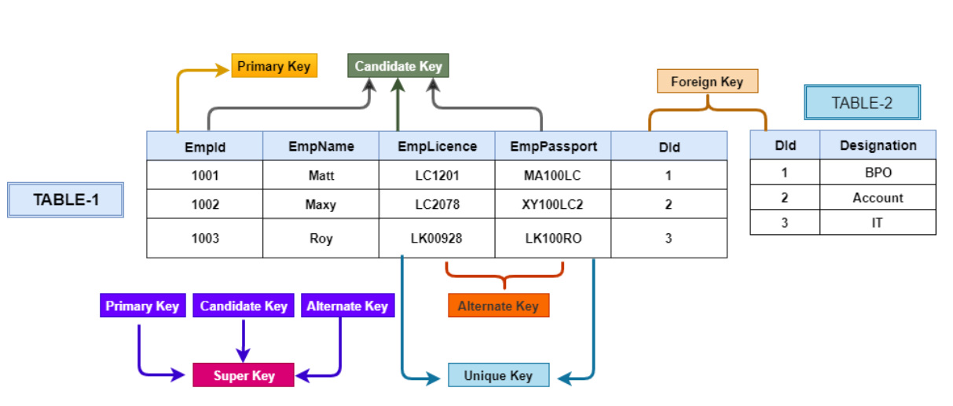
2. Keys & Relationships
Primary Key – Unique identifier for a row in a table.
Foreign Key – A field linking to the primary key of another table.
Composite Key – Combination of two or more columns used as a unique identifier.
Candidate Key – Possible columns that could serve as a primary key.
Unique Key – Ensures all values in a column are unique.

Slide 18
3. SQL Commands
DDL (Data Definition Language) – CREATE, ALTER, DROP, TRUNCATE (structure-related commands).
DML (Data Manipulation Language) – SELECT, INSERT, UPDATE, DELETE (data-related commands).
DCL (Data Control Language) – GRANT, REVOKE (permissions).
TCL (Transaction Control Language) – COMMIT, ROLLBACK, SAVEPOINT (transactions).
4. Data & Query Concepts
Data Type – Defines the type of data (INT, VARCHAR, DATE, BOOLEAN).
NULL – Represents missing or unknown data.
Constraint – Rules applied to data (NOT NULL, CHECK, DEFAULT).
Join – Combines rows from two or more tables (INNER, LEFT, RIGHT, FULL).
Subquery – A query inside another query.
Alias – Temporary name for a table or column.

Slide 19
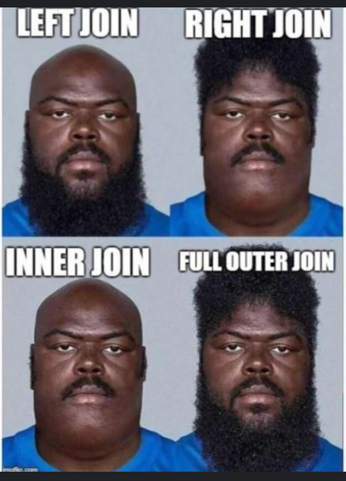
JOIN TYPES

Slide 20
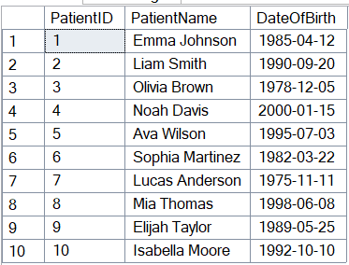
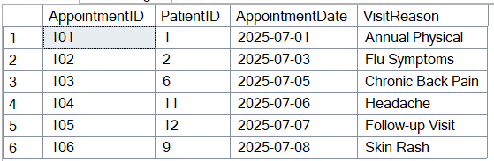
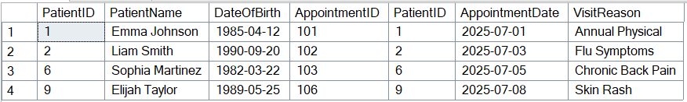
INNER JOIN
Shows only the matched rows where the PatientID exists in both the Patients table and the Appointments table.

Slide 21
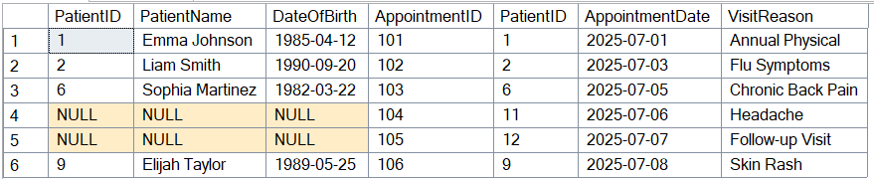
RIGHT JOIN
Keeps all rows from the Appointments table and adds data from the Patients table only when there's a match.

Slide 22
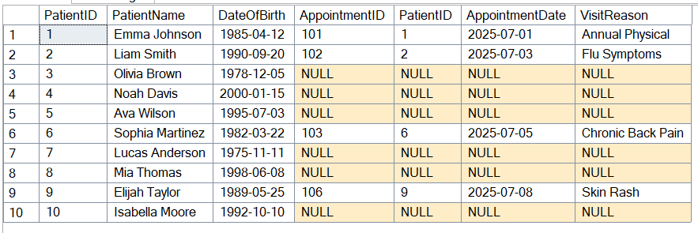
LEFT JOIN
Keeps all rows from the Patients table and includes data from the Appointments table only when a match exists.

Slide 23
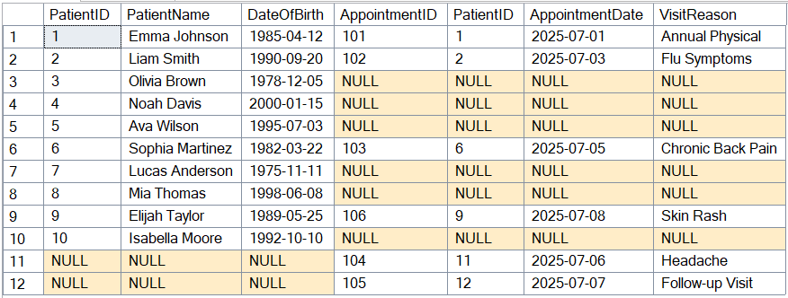
FULL OUTER JOIN
Combines all rows from both the Patients table and the Appointments table, matching where possible, and filling nulls where no match is found.

Slide 24
Summary Table
Join Type | Description
INNER JOIN | Only matching rows
LEFT JOIN | All left rows + matching right rows
RIGHT JOIN | All right rows + matching left rows
FULL OUTER JOIN | All rows from both sides
CROSS JOIN | Cartesian product of both tables
SELF JOIN | Join a table with itself
NATURAL JOIN** | Join on same-named columns (not in SQL Server)
ANTI JOIN | Rows from one side with no match on the other
SEMI JOIN | Rows from left where a match exists on right
** NATURAL JOIN is not supported in SSMS
<<Check out the SQL script how the BONUS join types work>>

Slide 25
Practice SQL Commands using the AdventureWorks database

Slide 26
SQL commands using the AdventureWorks database
The AdventureWorks database is a fictional retail business dataset created by Microsoft to demonstrate SQL Server features. It models a bicycle manufacturing company, so it includes:
Sales data (e.g., customers, orders, products)
Human resources data (e.g., employees, departments)
Production and inventory
Purchasing and suppliers

Slide 27
Entity Relationship Diagrams

Slide 28
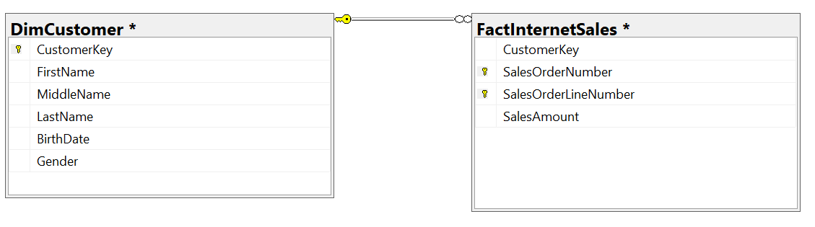
Types of Relationships in ERD:
One-to-One (1:1) Each record in Table A relates to exactly one record in Table B, and vice versa.
One-to-Many (1:N) One record in Table A can relate to multiple records in Table B. Most common relationship.
Many-to-Many (M:N) Records in Table A can relate to multiple records in Table B and vice versa. Usually implemented via a junction table.
The ERD represents a one-to-many relationship.
One customer (from the DimCustomer table).
Can have many sales transactions (in the FactInternetSales table).

Slide 29

Tiny Exercise-
Apart from the two tables shown, explore the various tables in the Adventure Works database.
Look for Primary Keys and Foreign keys.
Find two suitable tables that you can use to practice the JOIN types on the AdventureWorks database.
Create an ERD to show the relationship between two tables selected.

Slide 30
Create and load the Mimic-III Clinical database

Slide 31
Explore the MIMIC-III Clinical Database
MIMIC stands for Medical Information Mart for Intensive Care. MIMIC-III is a free, de-identified ICU database of 40,000+ patients (2001–2012) containing detailed clinical data for research in epidemiology, decision support, and healthcare analytics.
-It was developed by the MIT Laboratory for Computational Physiology to support research in critical care and healthcare analytics.
Physionet- https://physionet.org/
Mimic-III- https://physionet.org/content/mimiciii/1.4/
MSSMS do not support tables in .csv format directly and needs to be converted.
Convert the CSV files to SQL Server compatible files (.csv to .bak) on the SSMS platform
Create a database> Tasks>Import Flat File…>Load .csv file

Slide 32
Project- Using the MIMIC-III database, write an SQL query in SSMS to join the Admissions, Patients, and Caregivers tables to find each patient’s age, gender, admission details, and the number of caregivers involved per admission. Then filter the results for patients over 60 years old and sort them by admission date in descending order.

Slide 33
Epic Cosmos for Data Architecture

Slide 34
The Epic Cosmos Data Science Virtual Machine (DSVM) uses the SQL Server
Main database used- COSMOS
Other databases available- Clarity, Caboodle, etc.
Link- https://userweb.epic.com/

Slide 35
Thank you!

